Slide 1
Sepsis on Acute Care Floors
Meghna Trivedi, MD
Division of Hospital Medicine
Department of Medicine, University of Massachusetts Medical Center
October 31, 2018

Slide 2
Disclosure statement
I have no actual or potential conflict of interest
in relation to this program/presentation.

Slide 3
Learning objectives
Understand Sepsis definitions and facts
A hospitalist’s perspective of sepsis care on floors
Early Recognition Tools- Past and future
Sepsis Management guidelines
Brief overview of Quality Scholar’s project about improving time to antibiotics
Strategies to increase sepsis care bundle compliance
Sepsis documentation tips

Slide 4


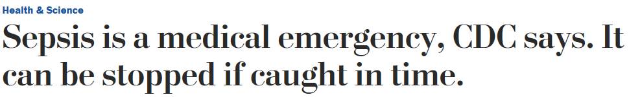
Sepsis: a medical emergency
Severe sepsis can deteriorate quickly into septic shock, cause organ dysfunction and become lethal. Early detection and prompt treatment of sepsis saves lives
Time = Life
Similar to acute MI, Trauma and Stroke, quick and appropriate interventions in the initial hours after development of severe sepsis influence patient outcomes
Many institutions are working diligently towards early recognition of sepsis and developing collaborative RN-MD protocols for sepsis care on the floor. These initiatives have shown to improve mortality rates

Slide 5
What is Sepsis?
Third International Consensus Definitions for Sepsis and Septic Shock (SEP-3) defines Sepsis as life-threatening organ dysfunction due to a dysregulated host response to infection
Septic shock is defined as a subset of sepsis in which particularly profound circulatory, cellular, and metabolic abnormalities substantially increase mortality

Slide 6
Sepsis definitions- Old V/S NEW
TERM | SEP- 1 (1992) | SEP- 2 (2001) | SEP- 3 (2015)
SIRS | ≥ 2 criteria: Temp <36 OR >38º C HR > 90 beats/min RR > 20/ min OR PaCO₂ < 32 mmHg WBC < 4000, >12,000 or >10% bands | Similar to SEP -1
SEPSIS | SIRS + Infection | Similar to SEP-1 | Suspected/proven infection + 2 or more qSOFA (HAT) OR Rise in SOFA score by 2 or more
SEVERE SEPSIS | Sepsis + Organ dysfunction or hypoperfusion | Use multiple organ dysfunction score or SOFA score
SEPTIC SHOCK | Sepsis induced hypotension (SBP <90 or ↓ in SBP of ≥ 40 from baseline) despite adequate fluid resuscitation | SBP <90, MAP <60 or ↓ in SBP of ≥ 40 despite adequate fluids resuscitation | Sepsis + Vasopresssors needed for MAP > 65 mmHg + Lactate > 2mmol/L despite adequate fluid resuscitation

Slide 7
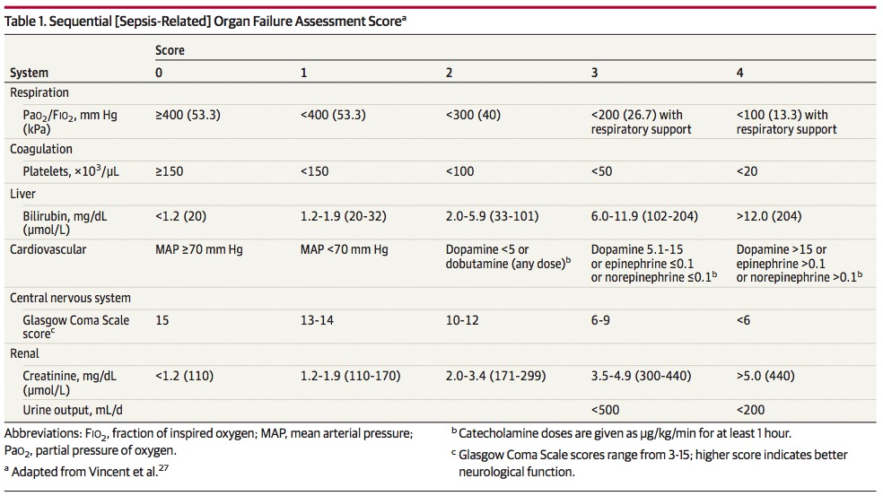
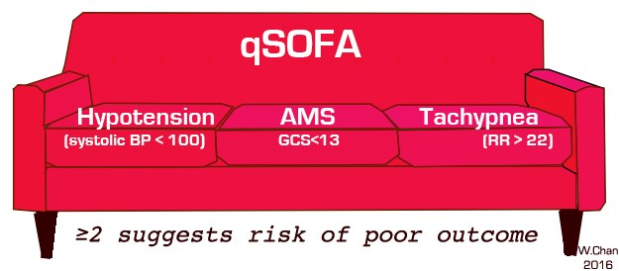
Organ dysfunction scores

Slide 8


Background
In 2013, the total cost of sepsis in U.S. hospitals was an estimated $20 billion, the greatest amount associated with any single diagnosis.¹
¹(Agency for Healthcare Research and Quality (AHRQ), Center for Delivery, Organization, and Markets, Healthcare Cost and Utilization Project (HCUP), National Inpatient Sample (NIS), 2013)
Notes:
Describe what is actually happening
Identify and quantify waste and value
Not just “what?”, but….
How much? How often? Trend vs. one-time?
Where – University, Memorial? 4th floor, NICU?
When – All the time; time of day; day of week?
Who – Is involved? Is impacted? Is the “customer”?
Which – Equipment? Supplies? Medications?
How…Does it work? …the process, the problems.
Consider…Safety, Quality, Delivery, Cost, Access, Value to the patient or other customer

Slide 9
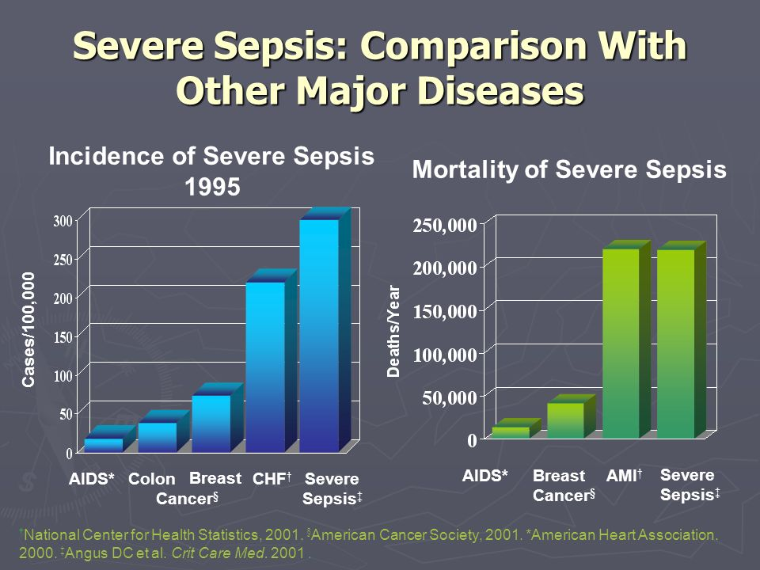
Why do we care about sepsis?
Long delay in recognition and initial treatment of Sepsis increases mortality
Sepsis is a leading cause of hospital readmissions. About 19% of patients admitted with sepsis get re-hospitalized within 30 days.¹
It is also associated with longer post- discharge rehabilitation stay, mental and physical disabilities and adverse events
The average cost per hospital stay for sepsis is $18,400, which is double the average cost per stay across all other conditions.²
About 40% US adults have not heard of sepsis
In May 2017, World health assembly (WHA) and World health organization (WHO) made sepsis a global priority and urged 194 member states to improve the prevention, diagnosis and treatment of sepsis
¹ https://www.hcup-us.ahrq.gov/reports/statbriefs/sb196-Readmissions-Trends-High-Volume-Conditions.jsp
^{2.} https://www.hcup-us.ahrq.gov/reports/statbriefs/sb146.pdf

Slide 10
Sepsis Stats at Umass
July 2017- June 2018:
Total # of admissions with primary or secondary diagnosis of sepsis → 2956. Highest admission rate in December 2017
Number of Sepsis related deaths → 459. Highest in February 2018
Number of 30 days readmissions → 470
49 patients each in Dec 2017 and June 2018
Mean Length of Stay (observed) → 10 days
June 2018:
Direct observed cost of care → $ 4,265,239
Total sepsis patients → 269
26 patients required ICU stay, 101 were discharged to rehab facility, 14 were made hospice, and 33 died

Slide 11


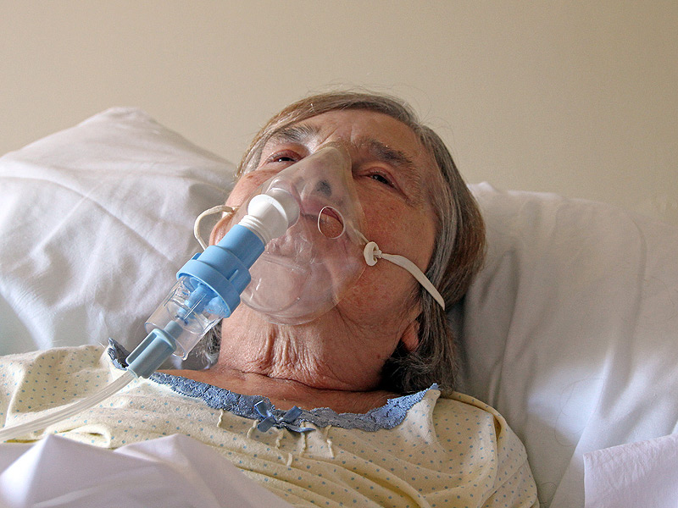
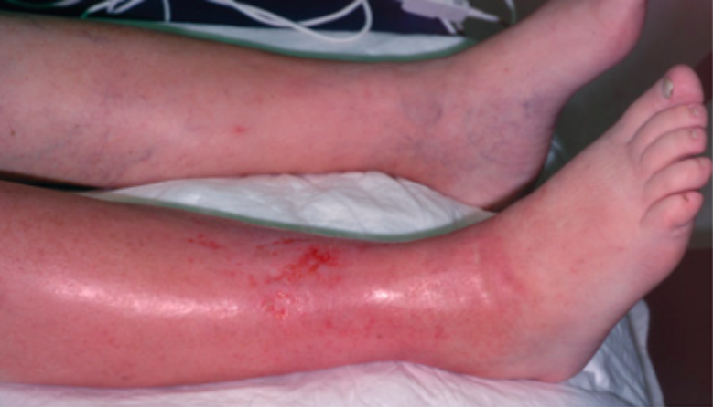
The Sepsis Continuum
Infection
SIRS
Sepsis
Severe sepsis
Septic shock
MORTALITY
Notes:
The continuum
Mortality keeps increasing through the continuum
Patient can present anywhere in this continuum
4. Pop up diabetic patient admitted with cellulitis, old grandma with fever and burning in the urine (SIRS), severe COPD patient admitted with pneumonia (sepsis), same patient becoming confused and with increasing oxygen requirement (severe sepsis), old grandma with septic shock from severe bilateral pyelonephritis
Not all elements of sepsis are always clearly evident eg. Immunocompromised patient may not always mount fever or have elevated white count.

Slide 12

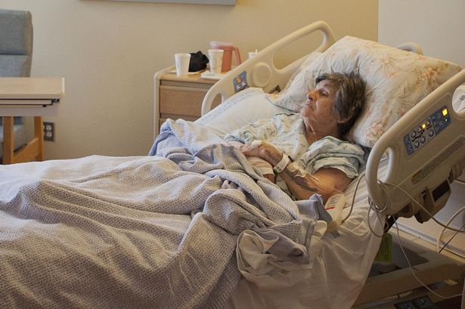
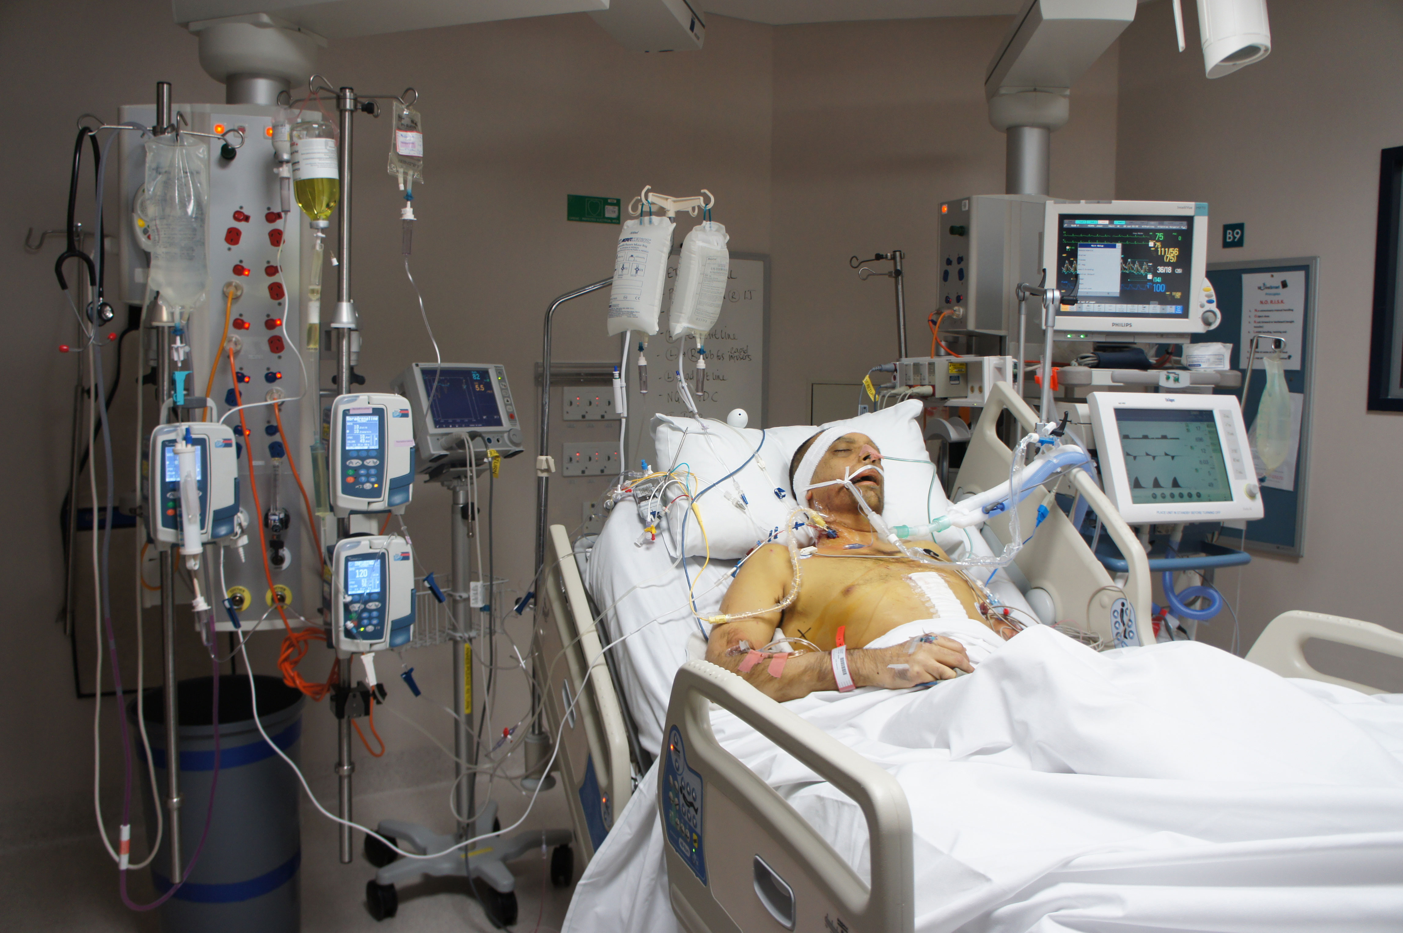
Where is Sepsis diagnosed and treated?
Notes:
1. Sepsis is diagnosed in ED, floor and ICU.
2. Given the inherent nature of urgency in ED and ICU, sepsis is recognized quickly and treatment starts early.
3. The patients present very sick and signs of sepsis are easier to recognize.
4. On acute care floors, sepsis can start out subtle making diagnosis difficult. Patient can start out with abnormal vital signs here and there, organ failure is not sometimes clearly evident.

Slide 13
Patient population at high risk for Sepsis¹:
Age >65 years
Diabetics
Alcohol abuse
Neutropenic
Chronic lung disease
Implanted devices
Hospitalist
¹Lauplant et al Crit Care Med 2004

Slide 14


Different settings = different care
Acute care floors ≠ ED or ICU
Hospitalists/Generalists ≠ Intensivists or ED physicians
Nursing ratio is different
Other resources like Phlebotomy, Respiratory therapists, and other staff may also vary by floor, weekdays/weekend etc.
Floor RN
ICU RN

Slide 15
Unique diagnostic challenges on floor
People
Methods
Inability to recognize sepsis
in a timely manner
Incomplete handoff to night float/ICU teams
Lack of standardized tools for early recognition of sepsis
Lack of knowledge of sepsis criteria, organ failure etc.
Anchoring bias by providers
“Time Zero” is not clear on floor
Inadequate communication between RN and providers
Delayed recognition
of Sepsis
Dyssynchrony between vitals, labs and assessments
Improper triaging of patients to floor due to flow issues
Lack of geographic cohorting of patients and provider teams
Inconsistent educational efforts around sepsis
Transfer to ICU during resuscitation adds a layer of complexity
Materials
Environment
Notes:
People- inability to recognize sepsis in a timely manner
Lack of knowledge of SIRS/SEPSIS criteria
Inability to recognize subtle changes leading to organ failure (eg. Platelets less than 1K related to sepsis)
Lack of communication between PCA/RN and providers
Lack of standardized tools for early recognition of sepsis
Improper triaging of patients- pt requiring ICU care comes to floor
Flow issues
Care providers: patient ration, especially in busy winter months
Anchoring biastransfer to ICU during resuscitation adds another layer of complexity

Slide 16
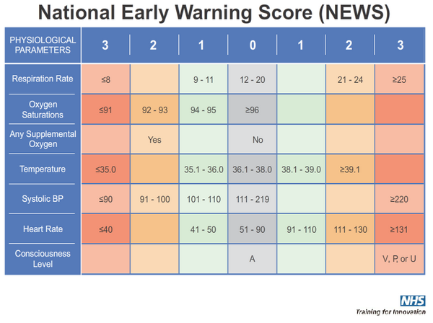
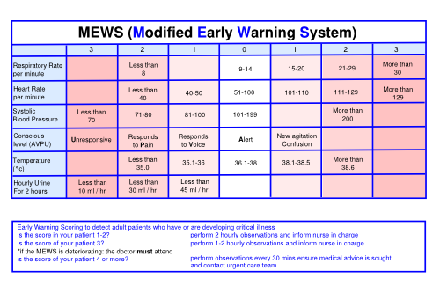
Sepsis Early recognition tools
Many institutions have adopted Sepsis early detection tools AKA Early Warning Systems with nurse driven protocols for rapid recognition and treatment of Sepsis
Use for early detection of deterioration in hospitalized patients and potential need for higher level of care. This score is meant to be used on a regular basis and not just on admission
NEWS 1-4 → prompt assessment by RN to determine escalation of care
NEWS 5-6 → urgent review by physician for consideration of ICU transfer
NEWS ≥ 7 → prompt assessment by clinical team and usually require transfer to ICU
Similar to NEWS
A score ≥ 5 is statistically linked to higher rate of ICU admission or death
If any single physiological parameter scores +3, consider higher level of care

Slide 17
“Sepsis ALERT” PILOTS AT UMASS
Pilots on 2 South at Memorial Campus (May 1, 2017- July 1, 2017) and 3 East (July 27, 2017- Early October 2017)at University campus
Nurses completed e-learning, attended huddles and meetings with Michelle Kelley. Sepsis Physician Champions (Drs. Kennedy, Ambrus and Trivedi) worked on provider education
Every patient was screened every shift, every day using a paper tool. Compliance rate for tool completion was ~70%. Appx 10 alerts at Memorial and 7 at University
Big challenge: EPIC training and go live dates around the time of pilots. Enthusiasm from nursing side was great!

Slide 18
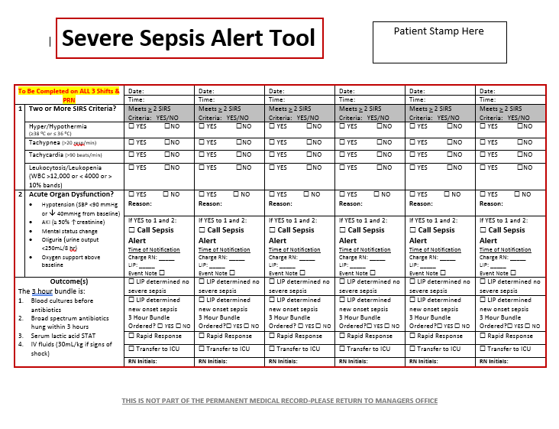

Slide 19
Sepsis PAM AND bpa in EPIC
Sepsis Predictive analysis Model (PAM) is an epic built tool that uses 68 variables to predict the risk of sepsis.
Variables: Demographics, Vitals (HR, Temp, not BP), last 24 hrs lab results, medication orders, co-morbidities from problem list and PMH etc.
Caveats: Clinical judgement is very important as the model can miss ~20% cases of sepsis and it may fire where 75% cases are not true sepsis.
When it does not fire, it is very reassuring that the patient does not have sepsis.
A sepsis score is generated based on PAM. Sepsis score of 7 or greater will generate a BPA for care providers if sepsis is not on the problem list
BPAs have gone live in Health Alliance and Clinton, as well as Medical Center Emergency departments. They will go live on inpatient side in very near future!

Slide 20
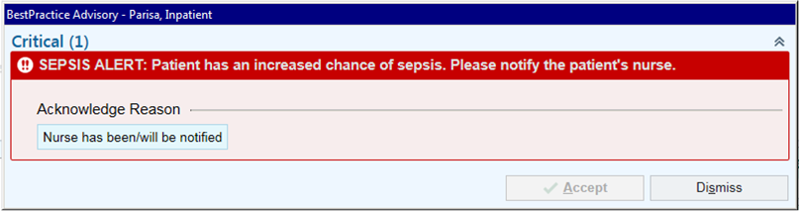
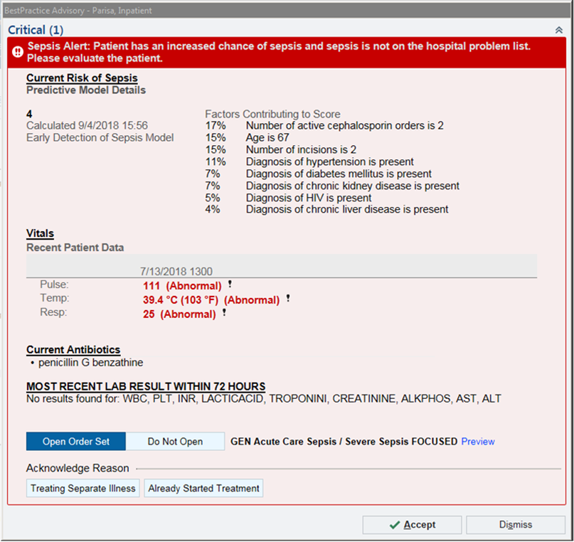
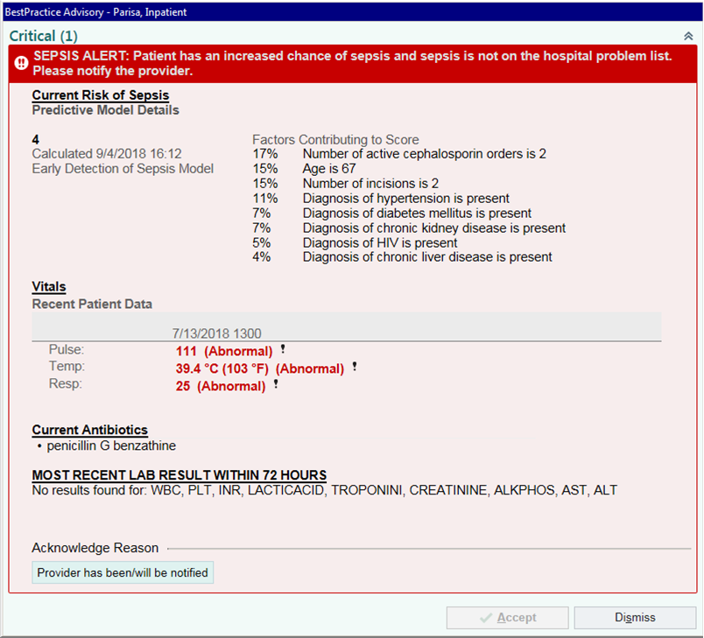
PCA
RN
MD

Slide 21
Bundle based care in sepsis
To be completed in 3 hours:
Lactate
Blood cultures x2
STAT broad spectrum Antibiotics
IV fluids @ 30 cc/kg bolus for hypotension or Lactate >4 mmol/L
To be completed in 6 hours:
Reassess volume status and tissue hypoperfusion
Support with Vasopressors for hypotension refractory to IV fluids
Repeat lactate if initial is elevated
2018 SSC bundle updates recommend doing all these in 1 hour!!!

Slide 22
Unique Treatment challenges on the floor
IV Fluids
Blood culture
Antibiotics
Lactate

Slide 23
“ Obtain two sets of blood cultures prior to administration of antibiotics”
30-50% of patients presenting with sepsis/septic shock have positive blood cultures
Failure to check blood cultures prior to administration of antibiotics may affect the growth of bacteria and culture may result as negative
In patients with catheters, blood cultures should be drawn from catheter hub as well as peripherally. When appropriate, other cultures like respiratory cx, urine cx, CSF cx etc. should also be obtained before antibiotics
Q) Patient is a hard stick. RN and Phlebotomy have tried multiple times to obtain blood cultures without success. It has been about 45 min since recognition of sepsis. How long should they wait before starting antibiotics?
Barriers to obtaining blood cultures on the floor:
Phlebotomy is short-staffed. Difference in staffing during nights/days/weekends
Difficult IV access
Potential solutions:
Phlebotomy comes within 30 minutes if paged/called for “Sepsis STAT”
Other available resources: Critical care RN, life flight crew, ICU colleagues

Slide 24

“Measure Lactate level”
Blood cultures
Lactate
Hyperlactatemia in sepsis is secondary to both aerobic and anaerobic metabolism, as well as decreased lactate clearance
Serum lactate is an important prognostic indicator in sepsis. A level over 4 mmol/L + hypotension is associated with a 46% mortality rate and level > 4 mmol/L alone has about 30% mortality rate. It can be used as a guide to determine effectiveness of the treatment
Caveat- Lactate is sensitive to sepsis but not specific! A falsely elevated level could be from a tight tourniquet left for too long, β agonists like albuterol, and in liver failure secondary to decreased clearance
Checking procalcitonin level along with lactate enhances the specificity in sepsis
Barriers and solutions on the floors:
- Difficult IV access, Phlebotomy not available → Same as in blood cultures
- Arterial sample v/s venous sample → Lactate reading from VBG sample is okay to use
- Lactate not ordered in sepsis patient → Education to care providers

Slide 25
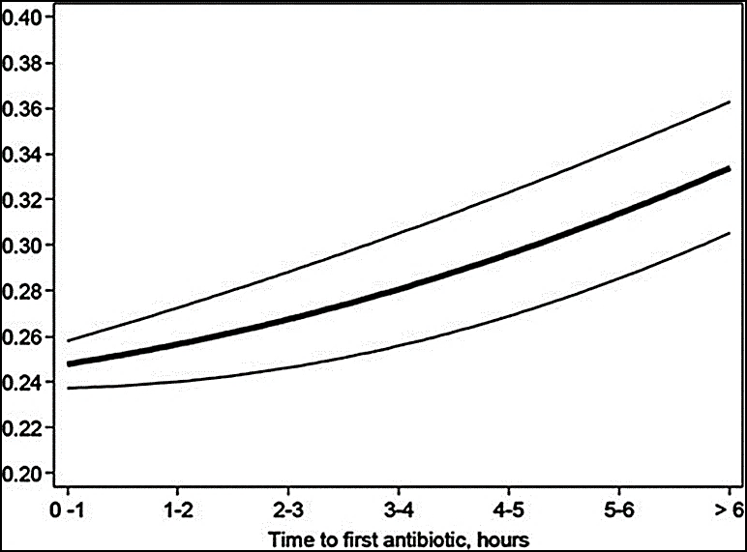
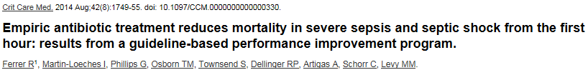
“Administer Broad Spectrum antibiotics”
Predicted Hospital mortality rate (per 100)
Conclusions: Delay in first antibiotic administration was associated with increased mortality. There was linear increase in risk of mortality with every hour delay in antibiotics.
Notes:
Large retrospective study done in 165 ICUs internationally.
28,150 patients with severe sepsis and septic shock, from Jan 2005-Feb 2010
Interventions: Antibiotics and hospital mortality
Results: Total 17,990 patients got antibiotics after sepsis identification. Adjusted In-hospital mortality was ~28%.
Conclusion: Delay in first antibiotic administration was associated with increased mortality. There was linear increase in risk of mortality with every hour delay in antibiotic administration.

Slide 26
Barriers to timely antibiotics on the floors:
- Antibiotics not ordered as STAT
- Broad spectrum antibiotics not ordered
- Certain antibiotics are not readily available in Pyxis
- Delay in obtaining blood cultures delays antibiotic administration
- IVF is chosen over Antibiotics
- Lack of communication between RN and provider
Potential solutions:
- Using Sepsis order set defaults antibiotics to STAT
- Order set with guideline based antibiotic choices. Common antibiotics used in sepsis are stocked in Pyxis
- Do not wait for >45 min to obtain blood cultures. Antibiotics can save lives.
- If patient is not hypotensive, give Antibiotics ASAP
- Administer antibiotics prior to ICU transfer if possible
- Verbal communication between RN and providers is crucial

Slide 27
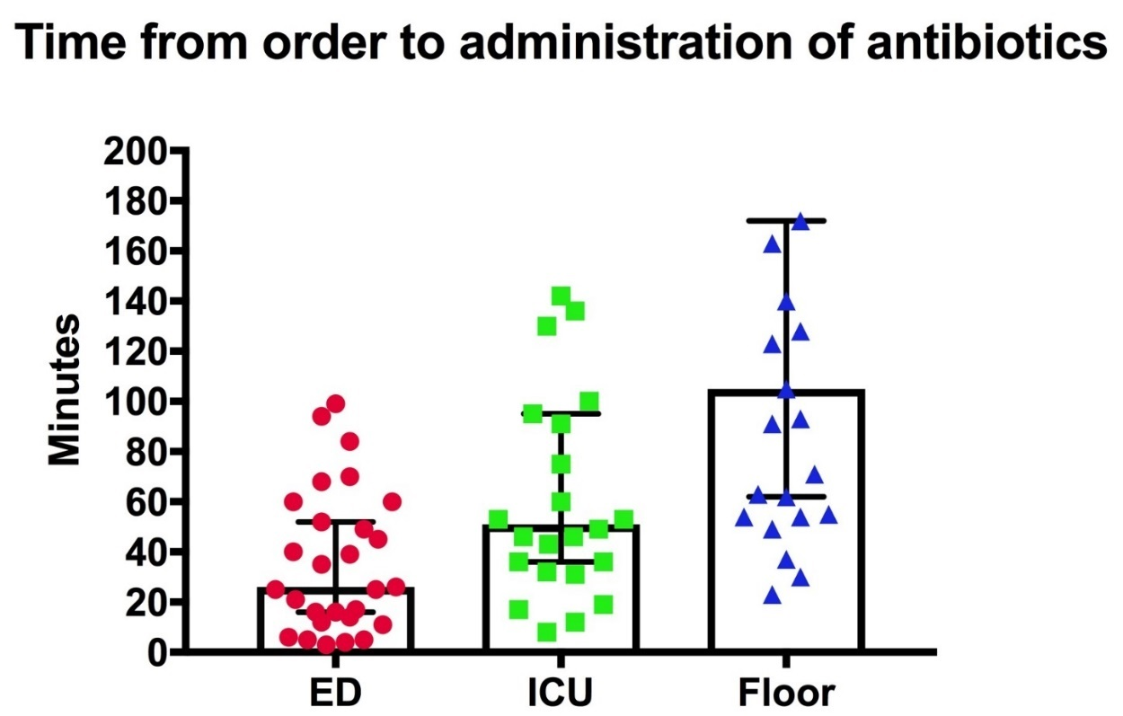
What is happening at UMass?
Patient charts with ICD-10 diagnosis of Sepsis admitted to Hospital Medicine service from October- December 2017 were reviewed.
Out of 154 patients, 29 patients (19%) admitted for other conditions developed sepsis on acute care floor.
Median time to administration of antibiotics was compared to patients with sepsis in ED and ICU
105 min
51 min
29 min
Notes:
MT notes- Out of 154 HM pts reviewed, 29 (~19%) developed sepsis on inpatient floor. Out of 29, 20 received antibiotics on the floor, 7 after reaching ICU and 2 were ED boarders. 31/154 patients either died during that hospitalization or within 4 months (noted during chart review). 4 pts were discharged to hospice care.
Median time for abx administration: ED 29 min, ICU 51 min and Floor was 105 minutes.

Slide 28
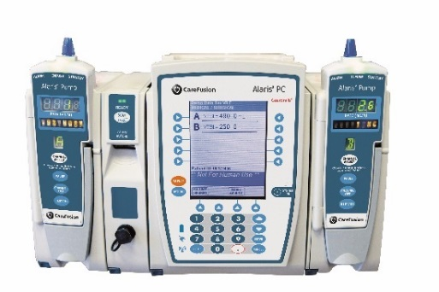
Provider recognizes sepsis
Nursing workflow
Antibiotics ordered routinely
Pharmacy workflow
RN receives and acknowledges order
Order goes in pharmacy verification queue
90 minutes+
Antibiotics administered to patient
Antibiotic verified by pharmacist
Establishes IV access
Awaits blood cultures before starting Abx
Orders IV Module in EPIC to administer Antibiotic (routine order takes 10-30 minutes to arrive)
RN gets Antibiotic
Antibiotic is dispensed within 90 minutes
Abx available in Pyxis
Tech runs it up to the floor
Abx tubed up to the floor

Slide 29

Provider recognizes sepsis
Nursing workflow
Antibiotics ordered STAT
Pharmacy workflow
RN receives and acknowledges order
Order prioritized in pharmacy verification queue
Antibiotic verified by pharmacist
60 minutes
Antibiotics administered to patient
Establishes IV access
Awaits blood cultures before starting Abx
Orders IV Module in EPIC to administer Antibiotic (STAT order takes less than 10 minutes to arrive)
RN gets Antibiotic
Antibiotic is dispensed within 30 minutes
Abx available in Pyxis
Tech runs it up to the floor
Abx tubed up to the floor

Slide 30
Countermeasures/Plan
(The 3 E approach)
FOCUSED Sepsis Order set creation
Collaborate with UHS for timely delivery of IV pump modules. UHS will educate nurses on STAT pump orders
Educate IM Hospitalists, Affiliate Practitioners, and IM house staff
Notes:
Devise countermeasures and visualize future state
Evaluate possible fixes based on effectiveness, cost, and time to implement. Which alternative solutions have you decided to trial?
Every countermeasure should be a Lean tool or use one or more Lean principles.
Every countermeasure should be eliminating waste and aligned with the Goals of the A3 project.
“Right-size” the countermeasure design.
Verify alignment with larger organizational goals.
Test solutions on a small scale, if possible.
Examples: Standard Work, 5S, Visual Management,
Meeting held with UHS director in June

Slide 31
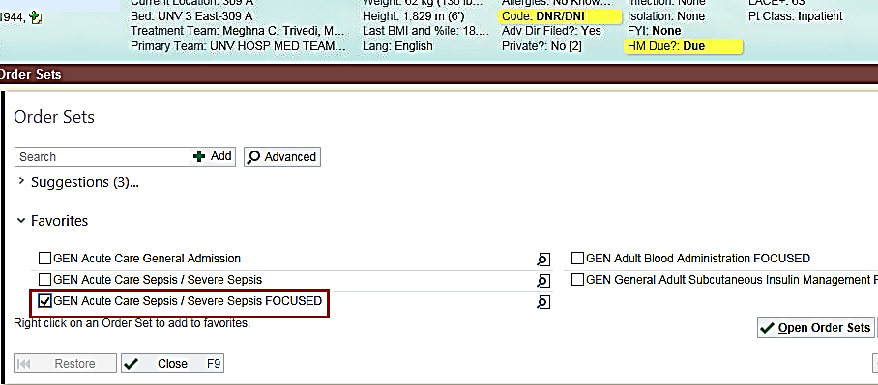
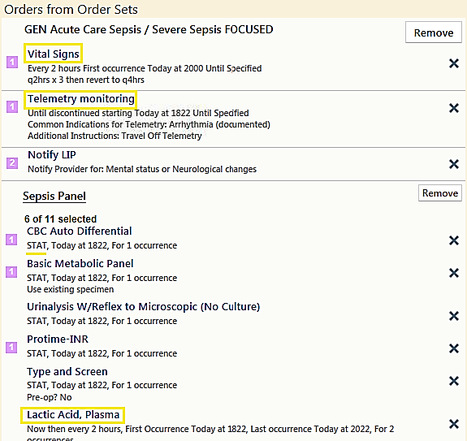
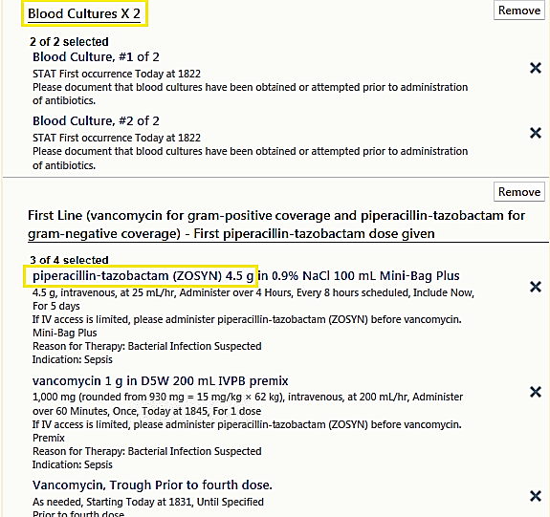
Order set was approved by the Sepsis Committee
Went live in Mid- August
It is also being used at Health Alliance and Clinton Hospitals

Slide 32
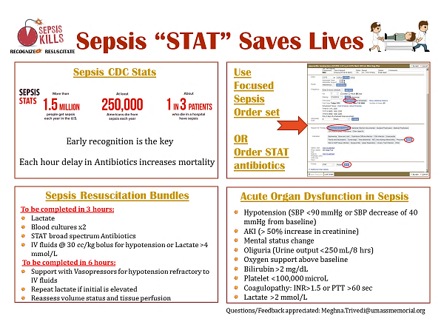
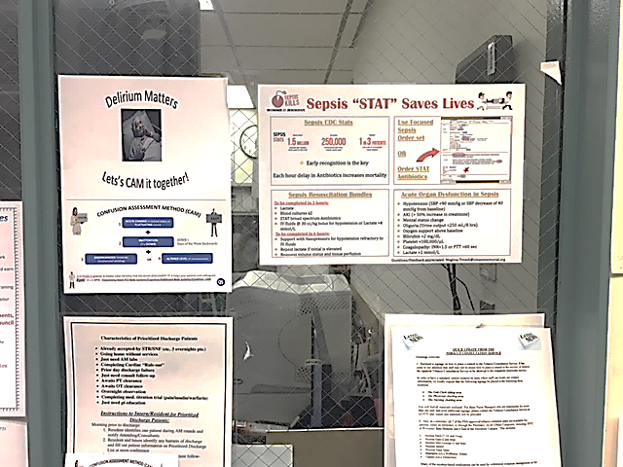
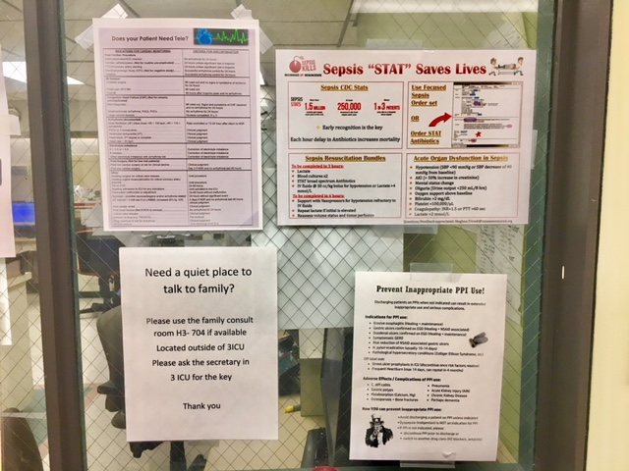
Sepsis Visual Aids have been posted in all key areas including medical floors and ER

Slide 33
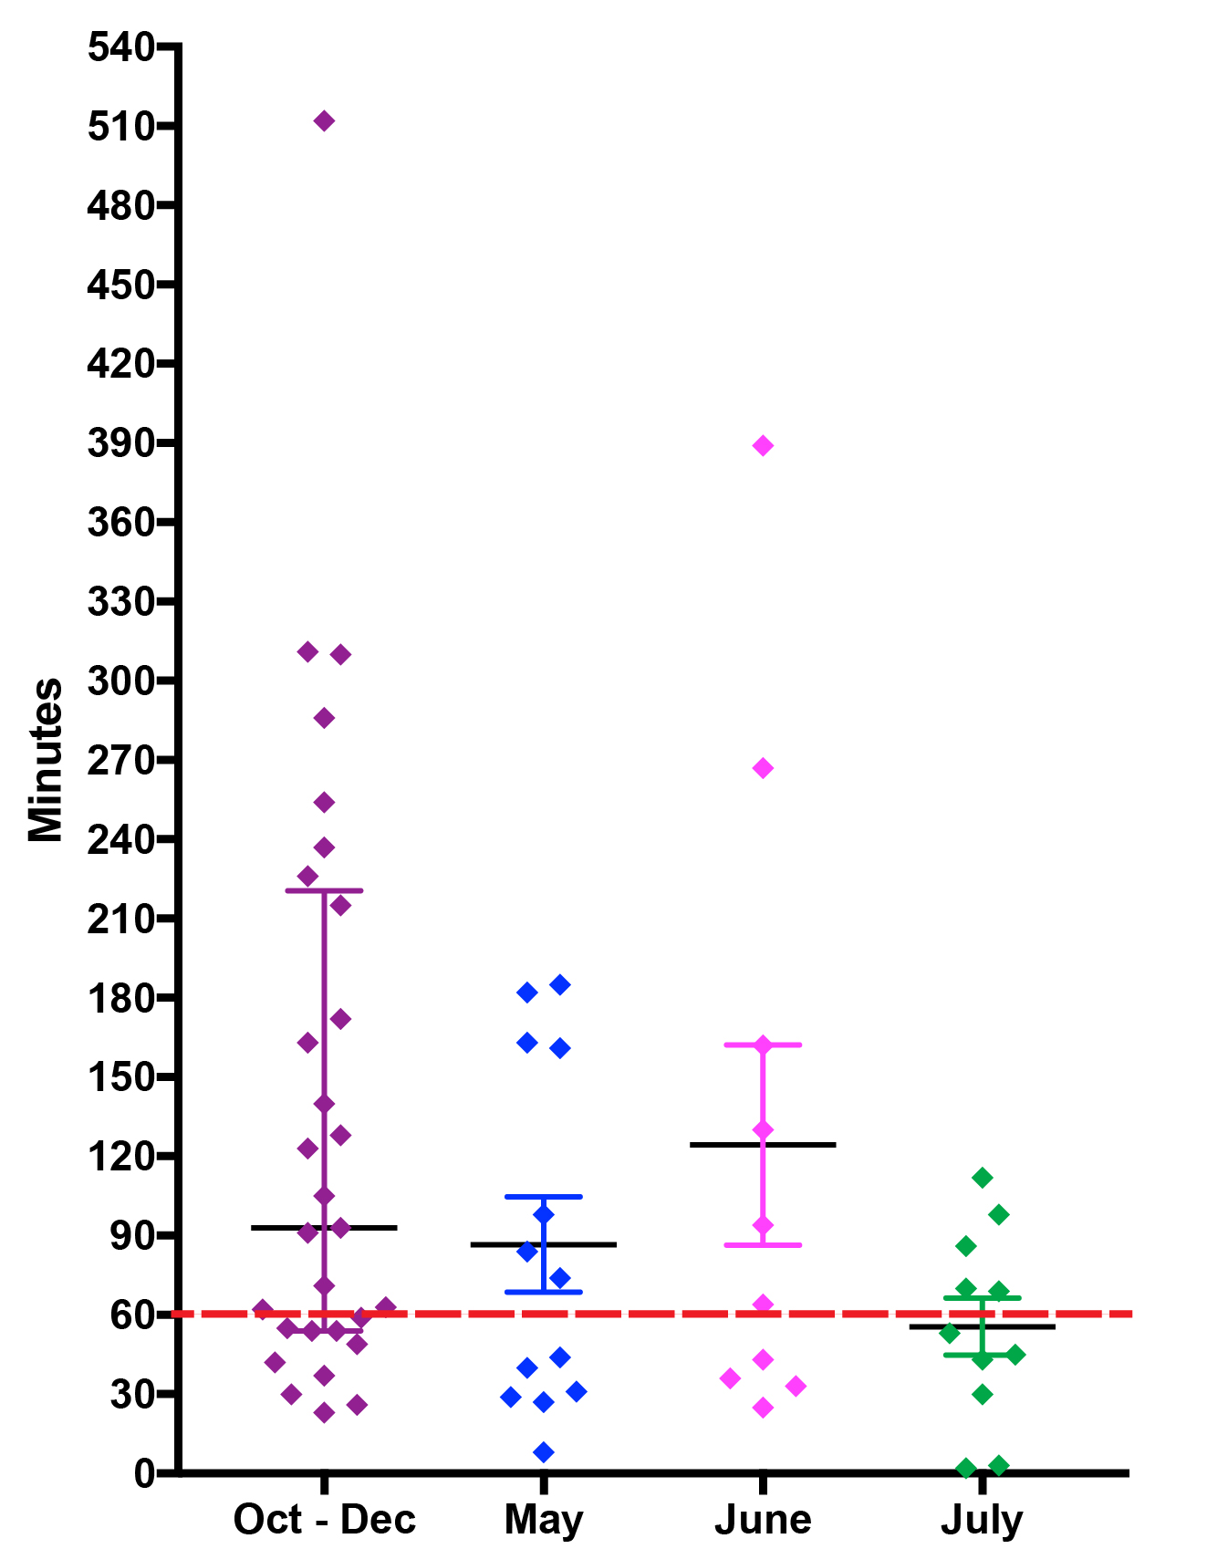
Study/Check
Month | Total HM sepsis admits | New sepsis on the floor | Median time: Abx Order to given | % pts getting Abx under 60 min
Oct-Dec 2017 | 154 | 29 | 105 min | 34.5%
May | 45 | 14 | 74 min | 46.2%
June | 63 | 10 | 79 min | 40%
July | 42 | 11 | 53 min | 56.5%
Interventions started

Slide 34
IV Fluids
“Begin rapid administration of 30 ml/kg of crystalloid for Hypotension or Lactate ≥ 4 mmol/L ʺ
Commonly used isotonic crystalloids- Normal Saline and Lactated Ringer’s solution (AKA Balanced crystalloid)
Fluid composition | Normal Saline (0.9% NS) | Lactated Ringer’s solution (LR) | Plasma
Sodium (mmol/L) | 154 | 130 | 142
Chloride (mmol/L) | 154 | 109 | 103
Potassium (mmol/L) | ― | 4 | 5
Calcium (mg/dL) | ― | 3 | 5
Lactate (mmol/L) | ― | 28 | Venous: 0.5-2.2 Arterial: 0.5-1.2
PH | 6.0 | 6.5 | 7.35-7.45

Slide 35
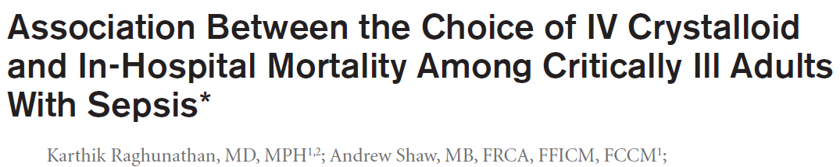
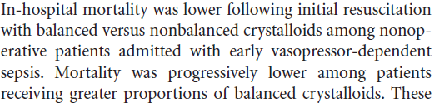

Does the choice of Crystalloids in sepsis affect patient outcome?
Take home point: LR is better for acute fluids resuscitation in sepsis

Slide 36
Administration of LR increases Lactic acidosis in septic patients- True or False?
FALSE
There is a fear that LR can worsen hyperkalemia and lactic acidosis in sepsis, but this is untrue
LR = Sodium Lactate ≠ Lactic acid
Heart and brain utilize lactate as bioenergetic fuel under ischemic conditions
Unless the patients have profound liver failure, accumulation of lactate is minimal and may be in fact beneficial
Conclusion- LR is a physiologically safe fluid choice in sepsis
Notes:
There is a fear that LR can cause hyperkalemia and lactic acidosis , hence LR is avoided in septic patients.

Slide 37
Barriers to IV fluids on the floors:
Adequate amount of IVF is not given in sepsis resuscitation
Culture of “1 L bolus then maintenance fluids”
There is a fear of volume overload (CHF or renal failure patients)
IV access issues
Potential Solutions:
Automatic IVF calculation in epic sepsis order set
Provider education
Frequent reassessment of fluid status by physical exam/bedside ECHO/CVP measurement
Nurse and provider communication
Phlebotomy/IV team/critical care stat RN/Life flight crew to help with establishing IV

Slide 38
Strategies to increase bundle compliance
Based on the sepsis score, BPAs have been firing in Medical Center ED, Health Alliance and Clinton Hospitals. Plan is to roll it out for inpatient side soon. It takes providers to the FOCUSED SEPSIS ORDER SETS which will ensure bundle compliance.
Sepsis timer
Annual Sepsis Education to nursing and providers
Billing and coding education for providers
Increase care provider involvement in Sepsis Committee

Slide 39

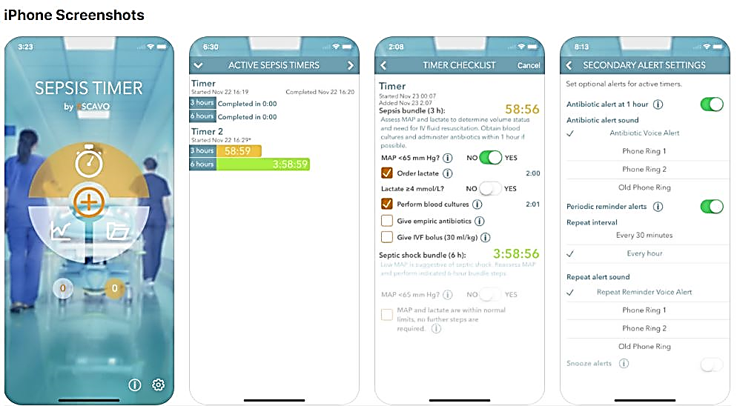
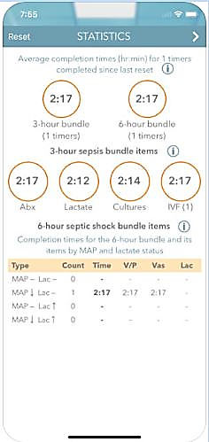
Escavo Sepsis Timer

Slide 40
Sepsis documentation tips
Sepsis is the number 1 Clinical Documentation Improvement (CDI) Query
Clearly document if Sepsis was present on admission (POA) as it drives principal diagnosis selection
Clear documentation of presumed/suspected or proven source of infection is important
BE CLEAR, BE CONSISTENT!

Slide 41
Acute organ failure linked to Sepsis must be clearly described. It is a mortality predictor
~ Examples: Acute Renal Failure related to Sepsis, Sepsis with associated acute respiratory failure
Septic Shock is Sepsis with hypotension refractory to adequate fluid resuscitation. Septic shock is a mortality predictor
~ Example: Severe Sepsis with Septic Shock
Consistency of Sepsis documentation is key!
~ Common pitfall is that Sepsis is initially documented but not thereafter. Document in discharge summary also
~ Evaluations and treatments must be discussed
~ If Sepsis was ruled out, clearly document it
Avoid using terms like Urosepsis. Document Sepsis secondary to UTI

Slide 42
Excellent Physician Sepsis Documentation
“Sepsis secondary to gram-negative UTI with associated end organ damage in the form of acute renal failure”
“She received four liters of IV fluid and was admitted to the intensive care unit, for hypotension refractory to fluids. Patient was started on a Levophed drip for septic shock.”
“Systemic inflammatory response syndrome secondary to acute gouty arthritis”

Slide 43


Acknowledgement
Thanks to Michelle Kelley, Dr. Kennedy and the Sepsis Committee
QS colleagues, QS Coaches and QS mentor Dr. Ambrus
IM residents

